Slide 1


Smart Solution for Railways
PSV College of Engineering &
Technology
Core Members
Sridhar S
Hariharan A
Madhan S
Thirumalai M
Guided By
Mr. Prakasam

Slide 2
SYNOPSIS
Introduction
Features
Existing Method
Proposed Method
Project flow
Block Diagram
Advantages
References
Conclusion

Slide 3


Slide 4
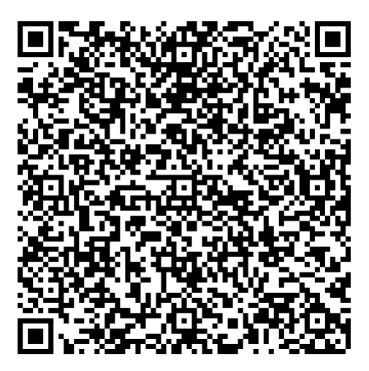
Features
A web page is designed for the public where they can book tickets by seeing the available seates
After booking the train, the person will get a QR code which has to be shown to the ticket collector while boarding the train
The ticket collectors can scan the QR code to identify the personal details
A GPS module is present in the train to track it. the live status of the journey is updated in te web app continuously
All the booking details of the customers will be stored in the database with a unique ID and if the TTR want to know details just show to scan to get details
Project Information

Slide 5
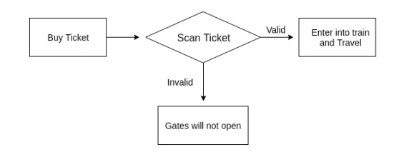
Existing Method

Slide 6
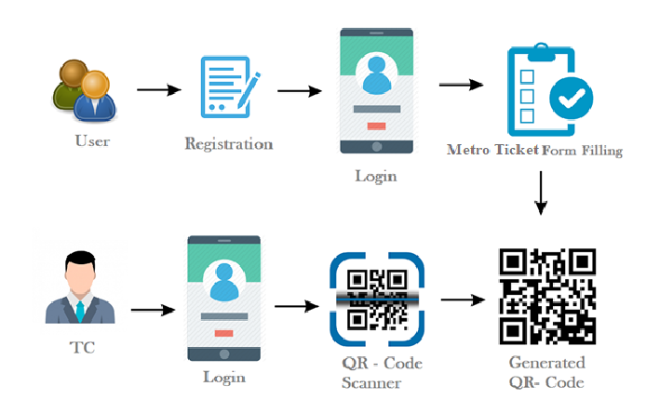
Proposed Method

Slide 7
Project Flow
Create and configure IBM Cloud Service
Create IBM watson IoT Platform and Device
Create Node - RED service
Develop the Python script
Used to Generate the QR code with unique ID
Develop a web Application using Node - RED service
Purpose of Testing the web UI by giving the required Input’s

Slide 8
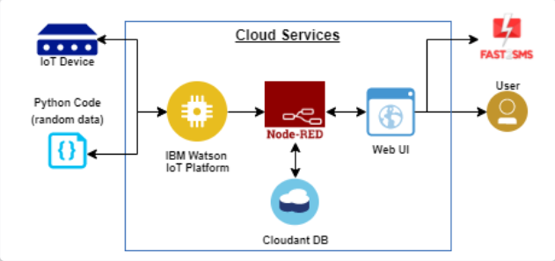
Block Diagram

Slide 9
Advantages
The main objective of the new system is to provide easy environment to purchase the
ticket for unreserved category without standing in the long queue.
Accurate data processing.
The records are dynamically updated.
Reduce passenger and computer operator time and money.
The information is stored in centralized server so quick in processing.
Reduce labour work.

Slide 10
References
[1] Joao Leal,Rui Couto,Pedro Mauricio,Teresa Galvao: IEEE tra- sanction on ”Exploring ticketing approaches using mobile technolo- gies:QR Codes,NFC and BLE” In:18th International Conference on In- telligent Transportation System (2015).
[2] Linli Hu, Yuhao Wang, Dong Li, Jing Li: IEEE transaction on” A hybrid client/server and browser/server mode-based universal mo- bile ticketing system”, In: ICIME.2010.
[3] V N Kamalesh, Vikram Ravindra, Pradeep P Bomble, M P Pa- van, B K Chandan, S K Srivatsa:” virtual ticketing International Research Journal of Engineering and Technology system” In: Inter_x0002_national Conference on e-Education,Entertainment and e-Management (2011).
[4] Yue Liu, Ju Yang, Mingjun Liu:” Recognition of QR Code with mobile phones”, In: -CCDC.2008.
[5] Li Li, Wu Chou:” Design and Describe REST API without Vi- olating REST: A Petri Net Based Approach”, In: IEEE International Conference on Web Services 2011.
[6] Beng Bao, L. Anantharaman, R. Deng:” Design of portable mobile devices based e-payment system and e-ticketing system with digital signature”, In: ICII.2001

Slide 11
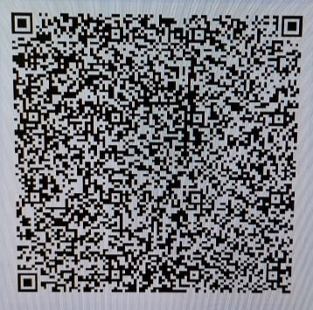
Here is there in my final output
If you scan this qr code you can able to review in he coustomer details along with the booking number !

Slide 12
Quarries ?

